Slide 1

KRISHI: ICAR GEO-PORTAL
Spatial Agricultural Research Information
http://krishi.icar.gov.in/geoportal
4-Aug-2015, NASC, New Delhi

Slide 2
Background
One of the Six Research Data Repositories of ICAR KRISHI Portal
Aims to provide a digital platform in public domain to
- to facilitate generation and compilation of data of agriculture having spatial context
- to store/host spatial database generated in NARS
- to provide visualization of spatial data as maps with contextual attributes
- to assimilate existing spatial agricultural data from other
sources
- to provide tools for analysis of spatial data
- to allow spatial data access and sharing to clients across platform and GIS flavours
- strengthen in-house technical capabilities

Slide 3
Status
Version 1 (beta) is online
  http://krishi.icar.gov.in/geoportal
  Some of the spatial layers finalized and made online
  Configured on ICAR Data Centre at IASRI
Version 2 with enhanced capabilities under development
  http://14.139.56.74:8080/geoexplorer/
  Available on development server at IARI

Slide 4
Technologies Used
Open source technologies
Total in-house development
Server Side
  Linux (Redhat ver. 6.x)
  Apache http server (ver 2.4)
  Apcahe Tomcat server (ver 7.0.6)
  Programming Language: PHP (ver 5.4)
  Geoserver (ver 2.6) : provide WMS service
  Database Engine: MySql, PostGIS
Client Side
  JavaScript
  OSM (Open Street Layer)
  Open Layers
  HTML, CSS, Jason
  CMS: Joomla

Slide 5
GeoPortal Features
Handles all type of spatial data
  Vector ( point, line, polygon), Raster, Quadtree
Highly configurable due to Open Source technologies
Extended functionalities
Compatibility across platforms
Provides Web Map Services (WMS)
Overlay State and district boundaries on any map
Open Source Base layer till street level details
Provision for users to upload their data directly to Geoportal

Slide 6
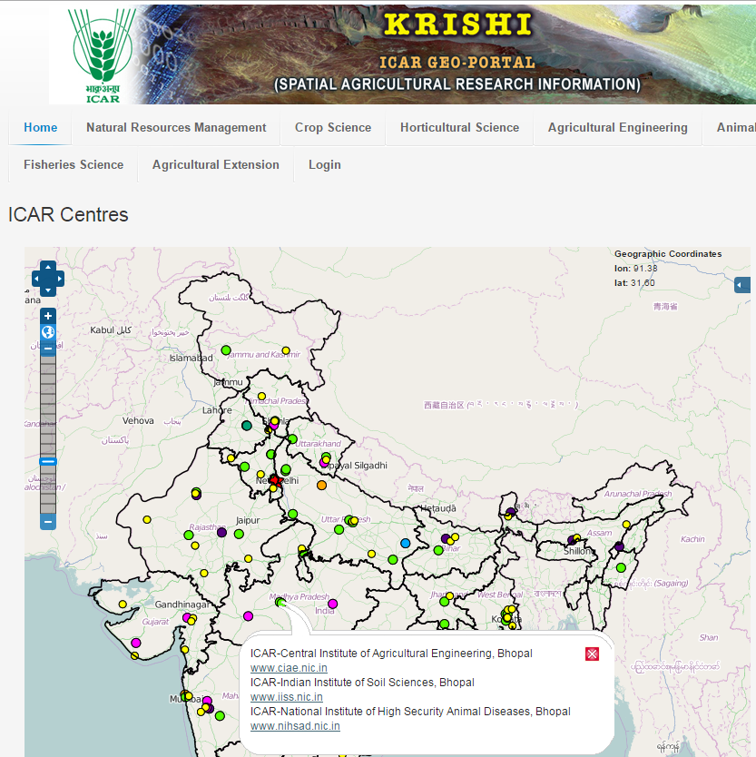

Slide 7
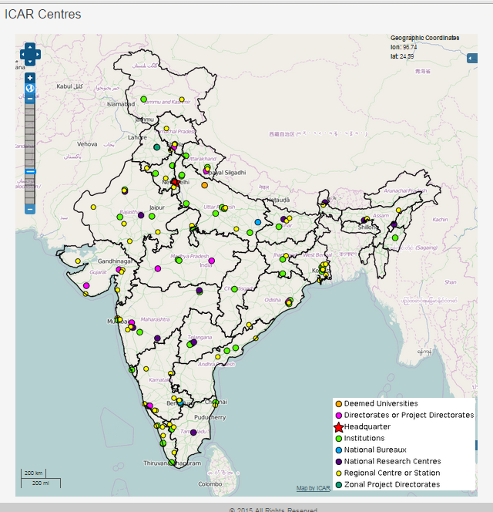
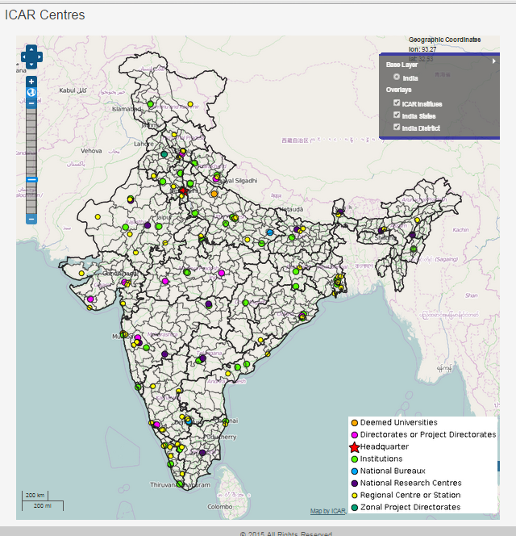

Slide 8
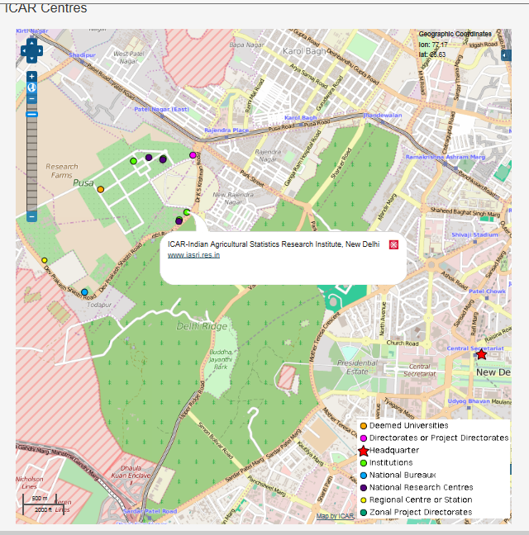

Slide 9
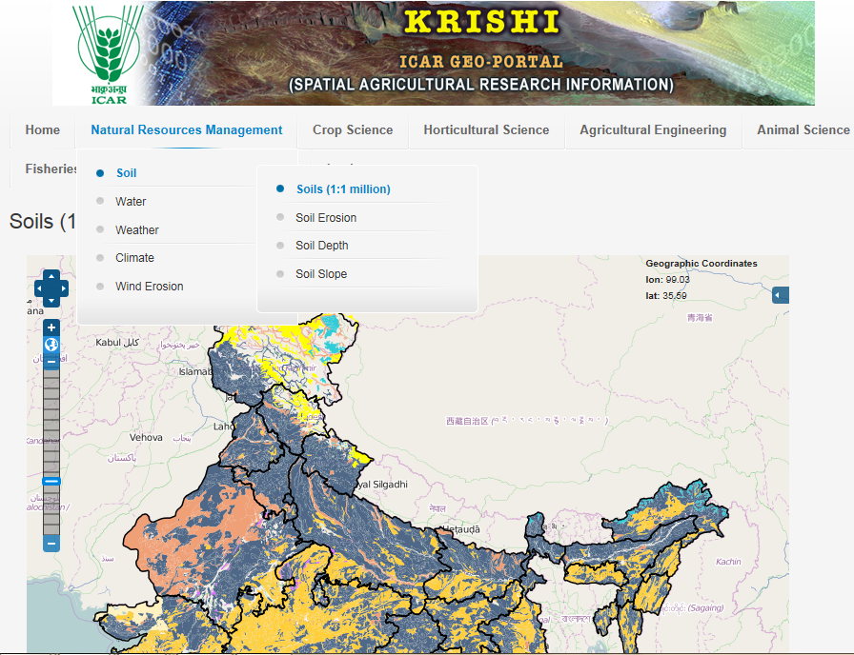

Slide 10
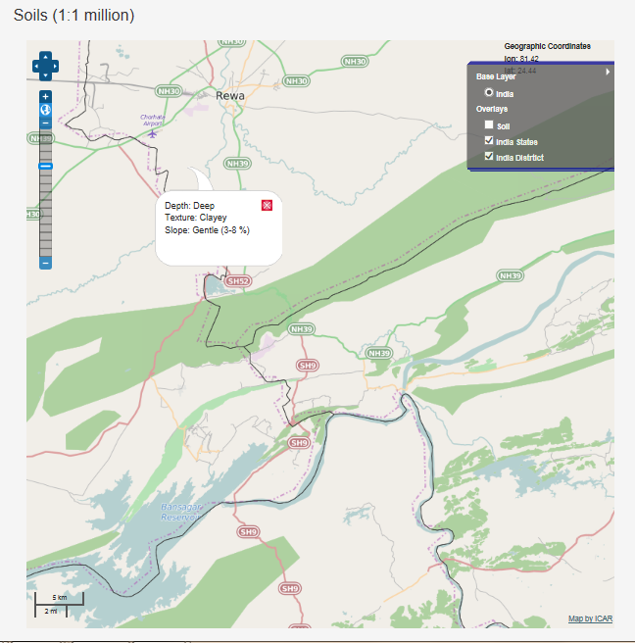
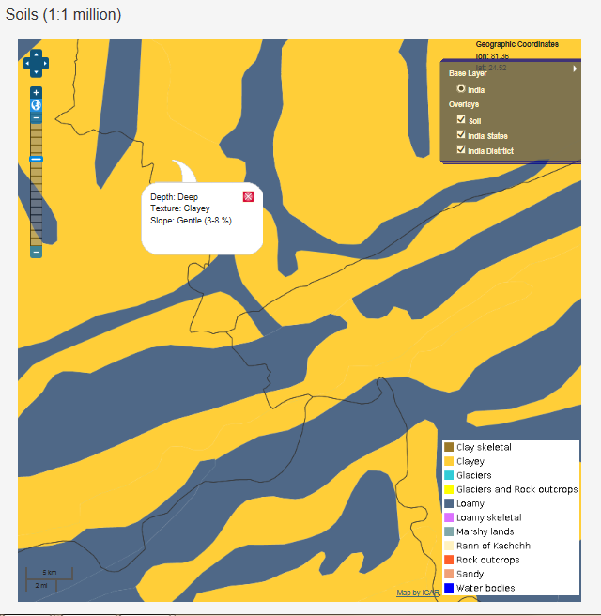

Slide 11
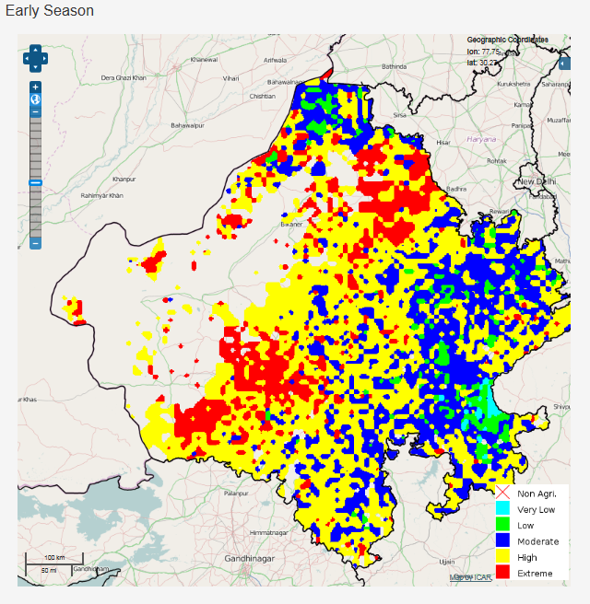

Slide 12
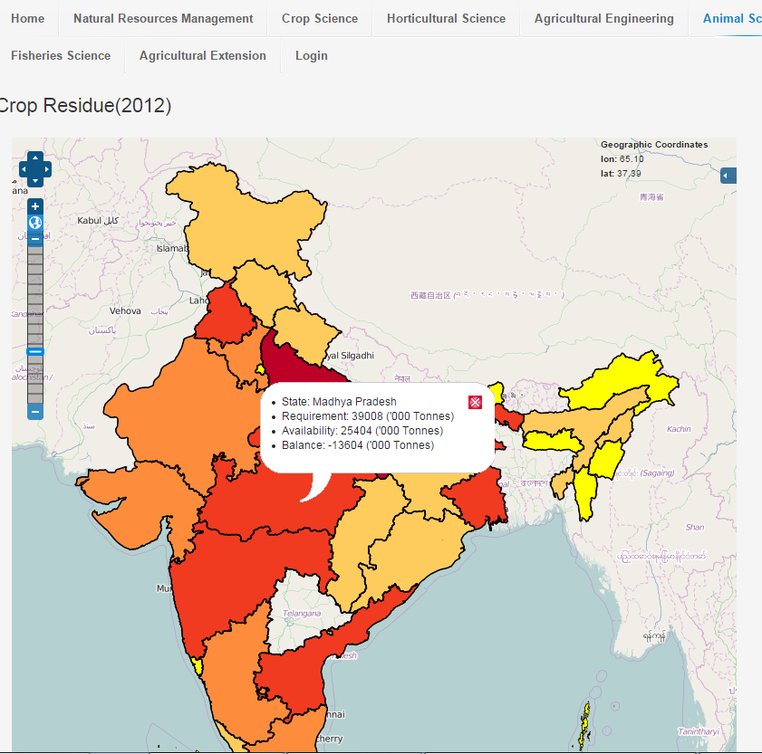

Slide 13
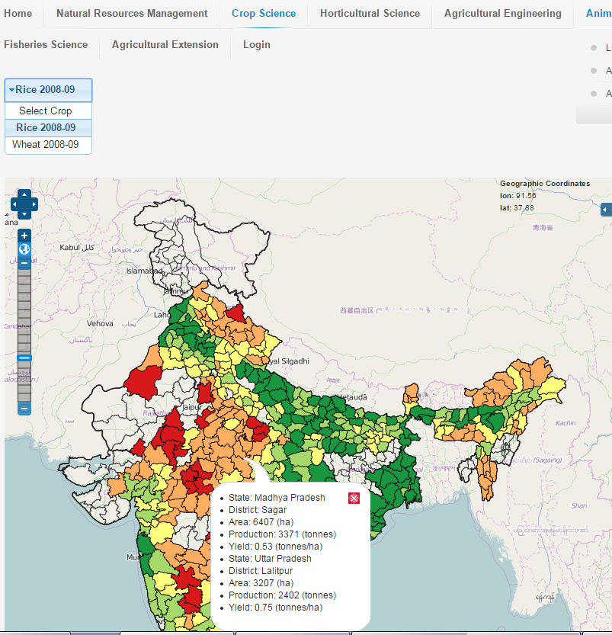

Slide 14
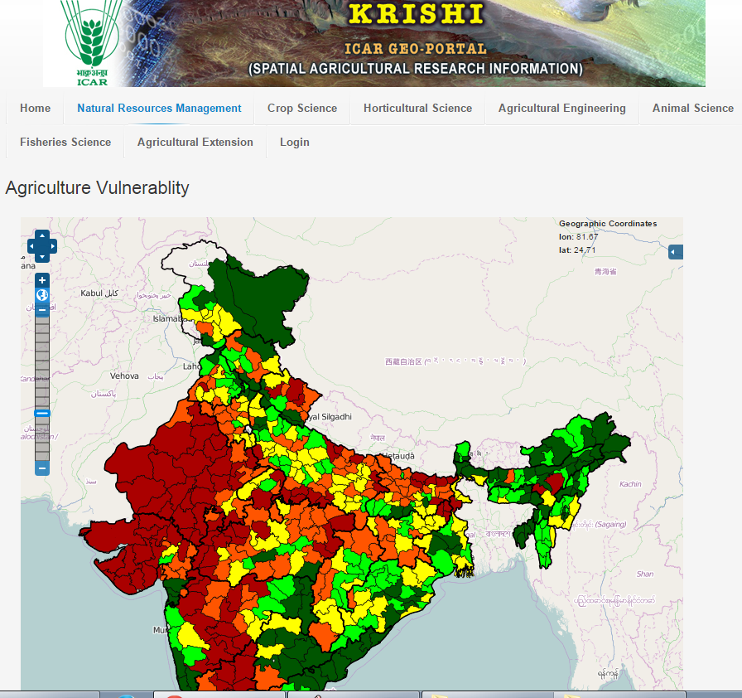

Slide 15
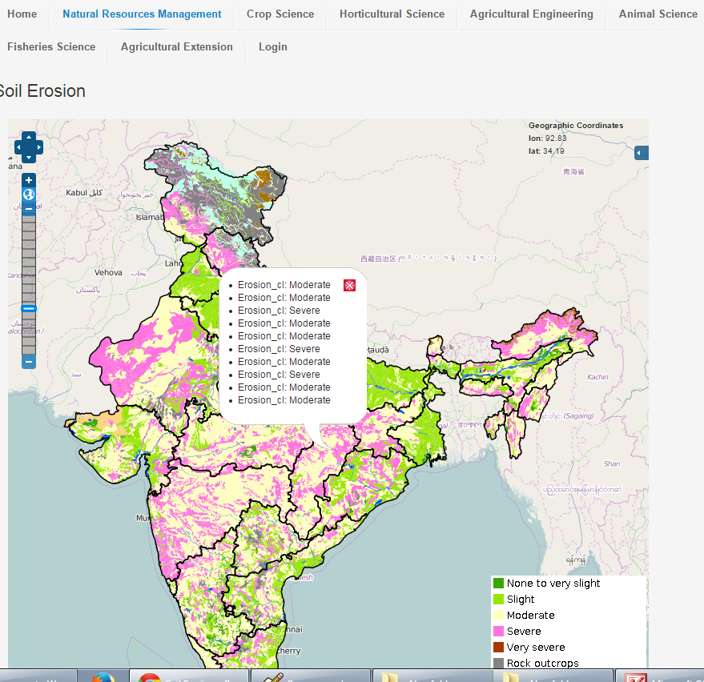

Slide 16
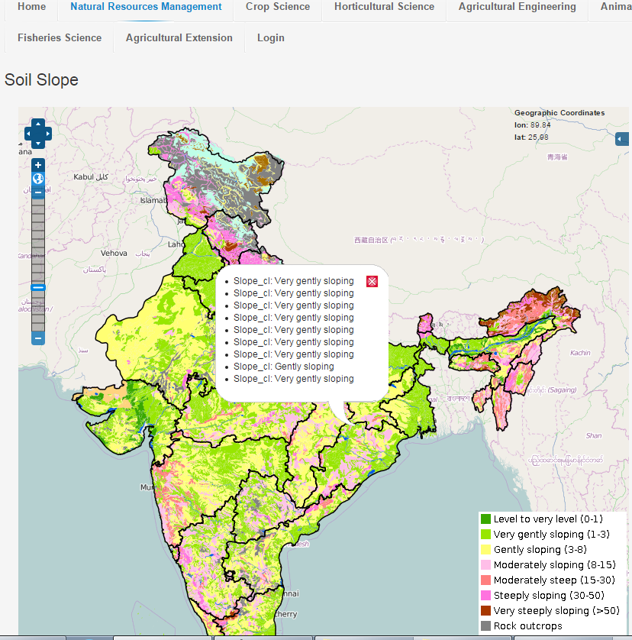

Slide 17
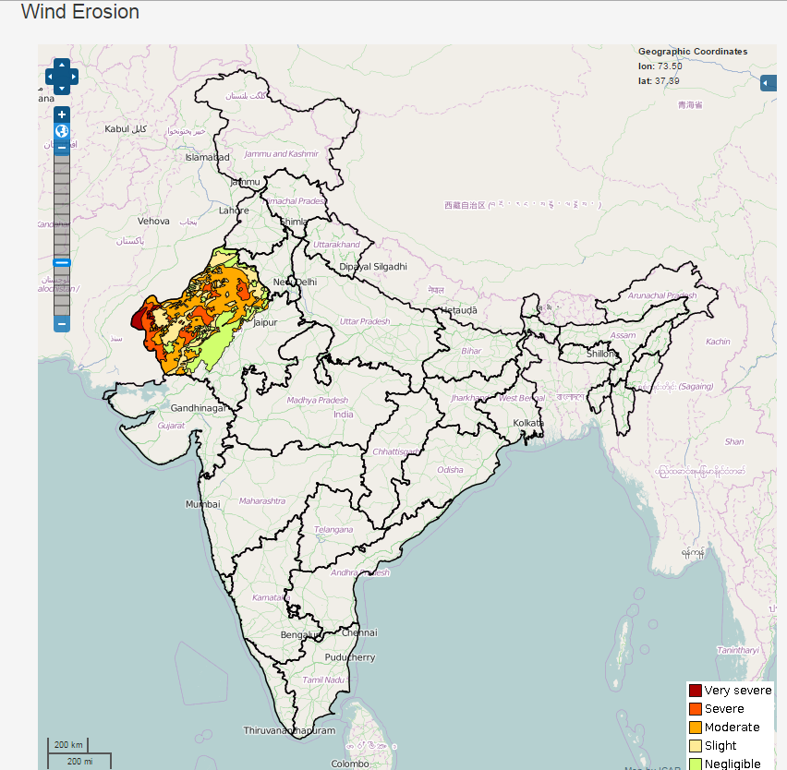

Slide 18
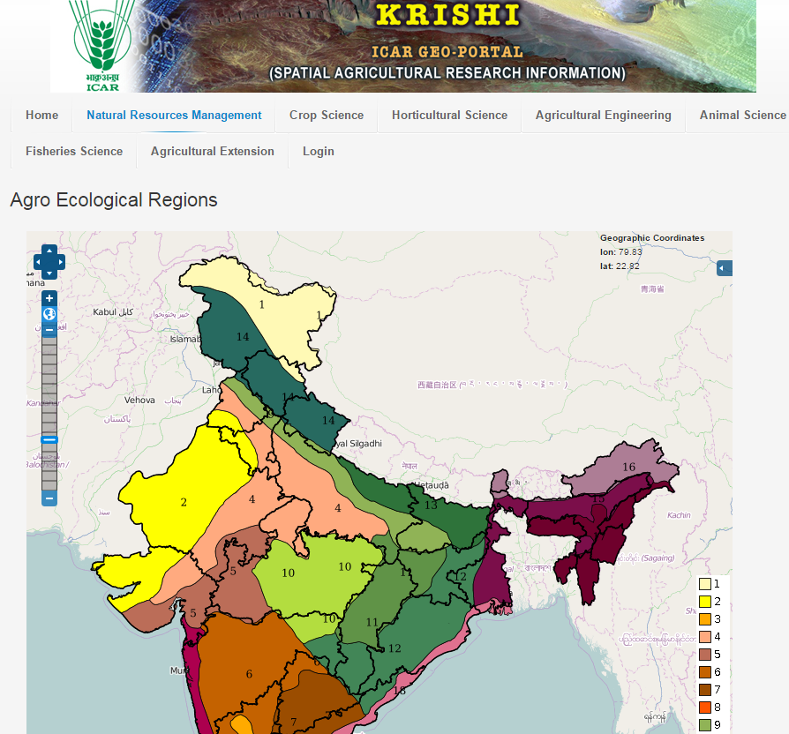

Slide 19
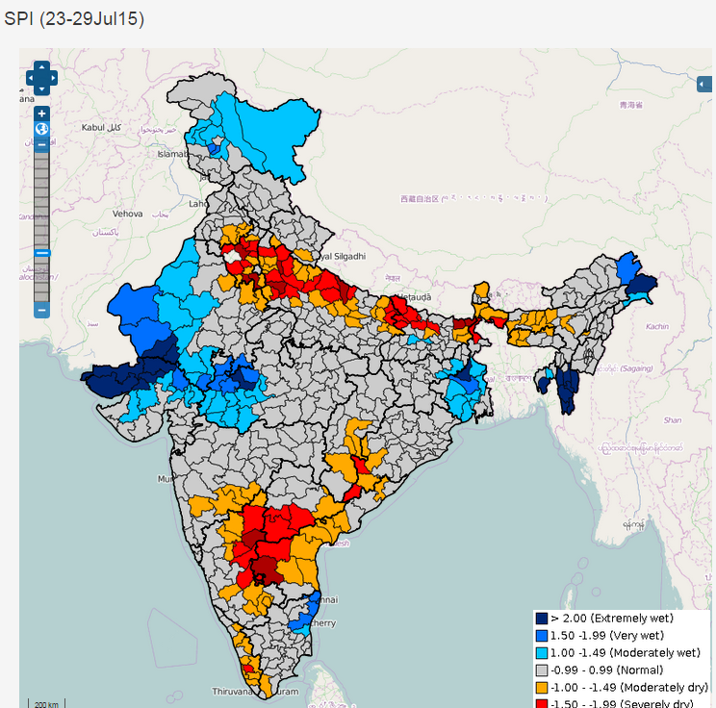

Slide 20
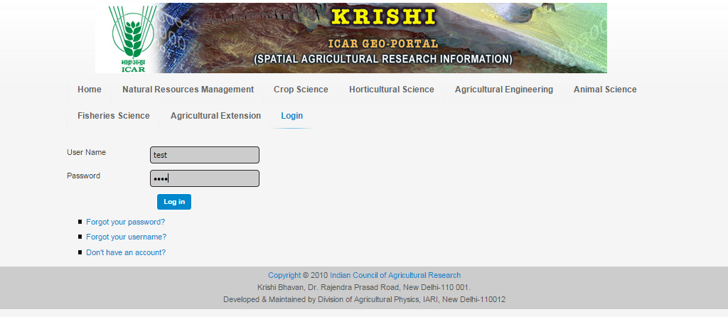
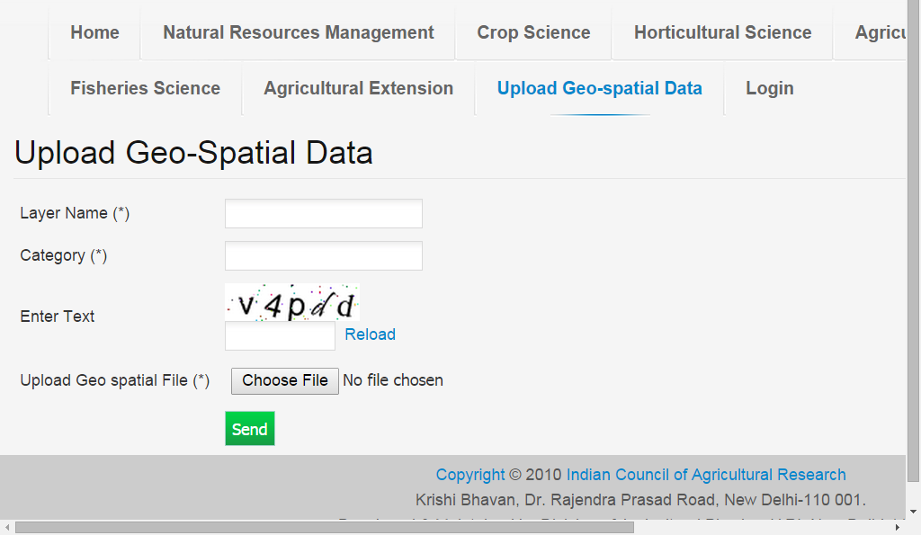

Slide 21
Geo-Portal Ver 2.0
  Live on: http://14.139.56.74:8080/geoexplorer/
An updated interface
  Two panels: Map Window panel, Layer panel
  Geoportal Toolbar and Map Window Toolbar
  Display of Layer Properties, Metadata and Layer Styles
  Selection of map scale
Selection of base layers: OpenStreetMaps, Bing, Google
Overlay of Map Layers: Order and Transparency
Enhanced Query: Map extent and Map attributes
Add WMS (Web Map Service) Layers from remote Geoservers

Slide 22
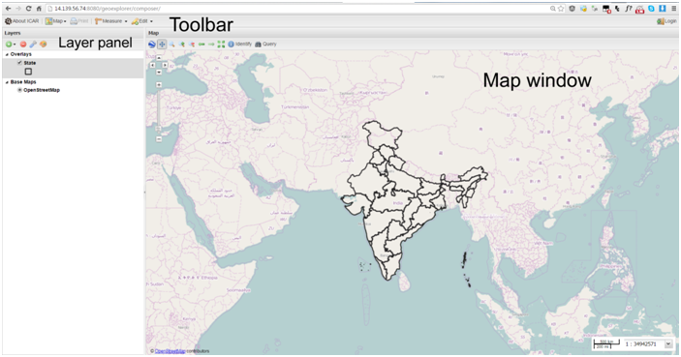
The Interface

Slide 23

Map Toolbar

Slide 24
Geoportal Toolbar

Slide 25
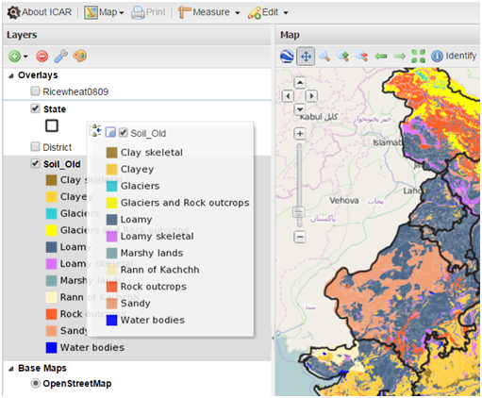
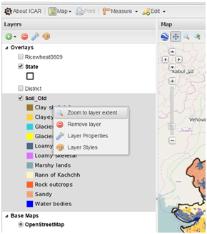
Layer Panel

Slide 26
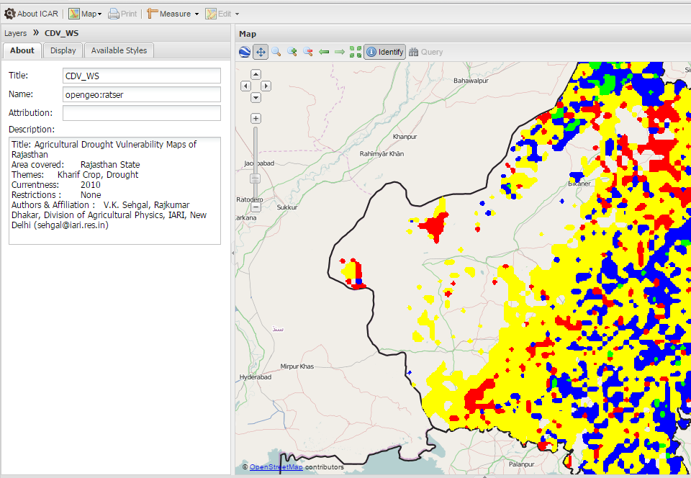
Layer Properties

Slide 27

Layer Properties

Slide 28
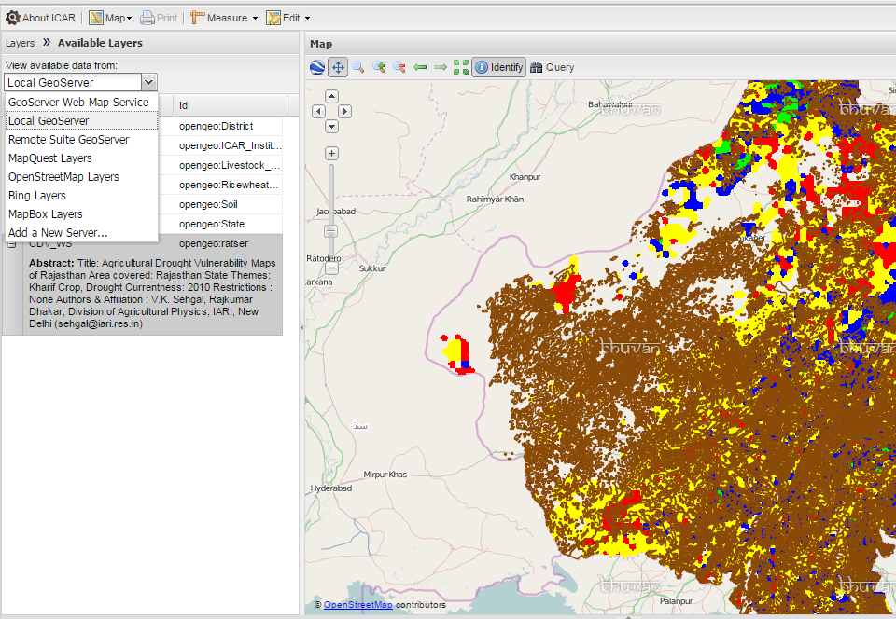
WMS Service

Slide 29
Way Forward
Practice and sensitize “Data Openness”.
Identify Spatial Data of your Subject Matter / Commodity
  Generated in your institutes,
  Generated in allied institutes
  Available in public domain
Identify Tabular Data with spatial context
  Current
  Historical
Digitization / reformatting of identified data
Be meticulous in generating “Metadata” of spatial data
Now on always generate data with precise “Geolocation”
  Experimental, Observational, Survey
Be an active partner of team KRISHI

Slide 30
Thank You
sehgal@iari.res.in
vksehgal@gmail.com
Acknowledgements
DDG(NRM), ADG(SWM), DIR(IASRI), DIR(IARI), DIR(NBSS)
Dr R. Prasad, Dr O. Reddy, Dr A. Dhandapani, Dr A.K. Choubey
Mr R. Verma, Mr Subhash
Mr Ashish Tiwari, Ms Priyanka, Ms Malti

Slide 31
Issues
Procurement of base layer data from Survey of India
Open Source vs Commercial Geoserver
How many concurrent users to be served?
Redundancy of Geoportal
Security of Data
Availability of Data to ICAR users / General users
Disclaimer about boundaries, geolocation, administrative boundaries etc.

Slide 32
http://bhuvan5.nrsc.gov.in/bhuvan/wms
http://14.139.56.74:8080/geoexplorer/

