Slide 1
Observational Data Repository --- AWS Data Management Lines
N Showri Raju Scientist ( Comp. Appl. in Agriculture)
CENTRAL RESEARCH INSTITUTE FOR DRYLAND AGRICULTURE
CRIDA-ICAR , Hyderabad 500059

Slide 2
Nature of Data Generated by CRIDA

Slide 3
Divisions in CRIDA & Observational Data Generated by them
DRM
- Experiments involving crops with
climate, water, soil, nutrients
DCS
- Experiments involving crops with
Genetics, Breeding, pests and diseases
SDA,TOT
- Survey Data , Trainings & Animal Experiments
AICRPDA(25)
- Field, Lab Experiments on mandated crops
AICRPAM(25)
- Metrological data collection & Field Experiments

Slide 4
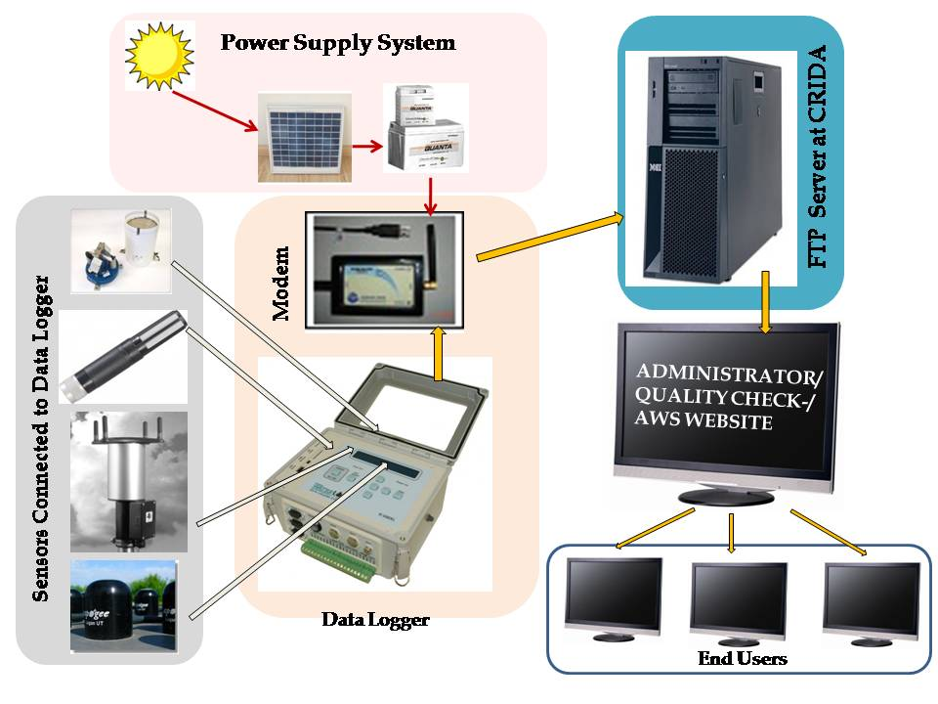

Slide 5
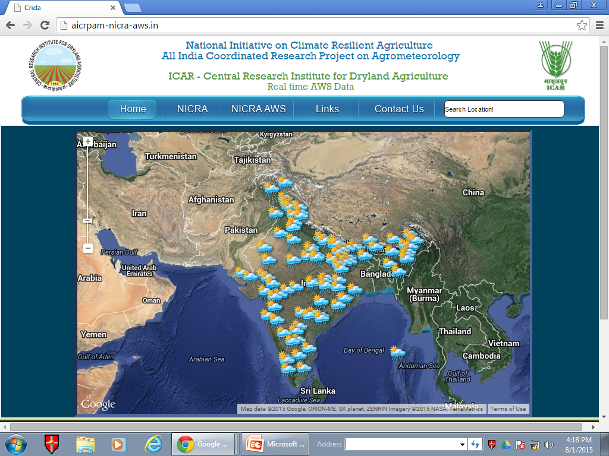

Slide 6
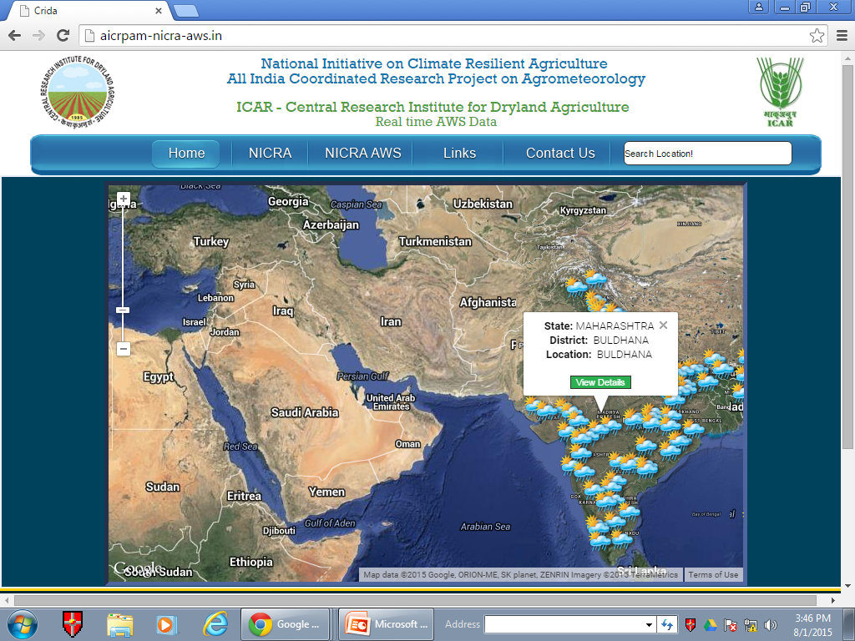

Slide 7
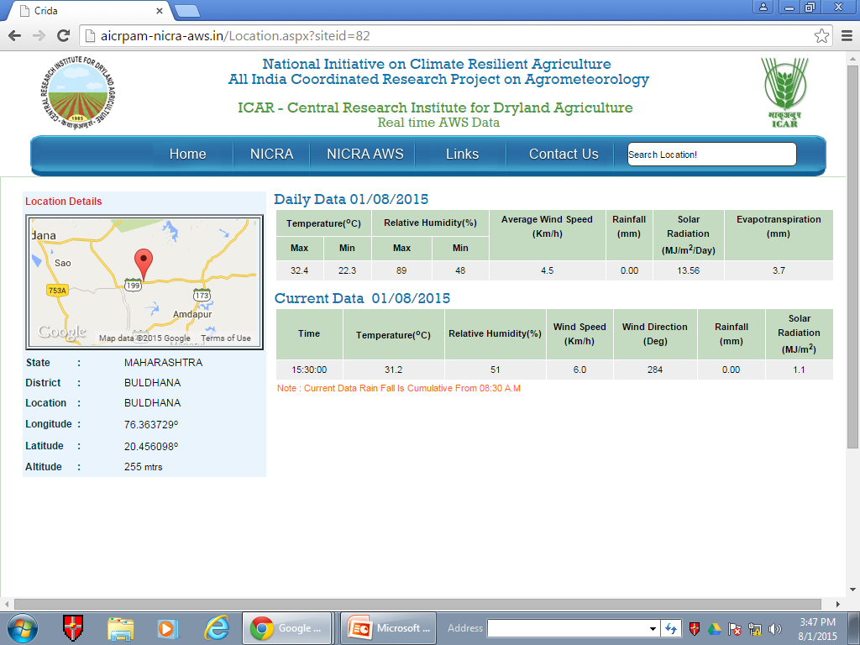

Slide 8
Contingency plans
District level contingency plans cover contingency strategies to be taken up by farmers in response to major weather related aberrations such as
-Delay in onset and breaks in monsoon causing early, mid and late season droughts, floods, unusual rains.
-Extreme weather events such as heat wave, cold wave, frost, hailstorm and cyclone.

Slide 9
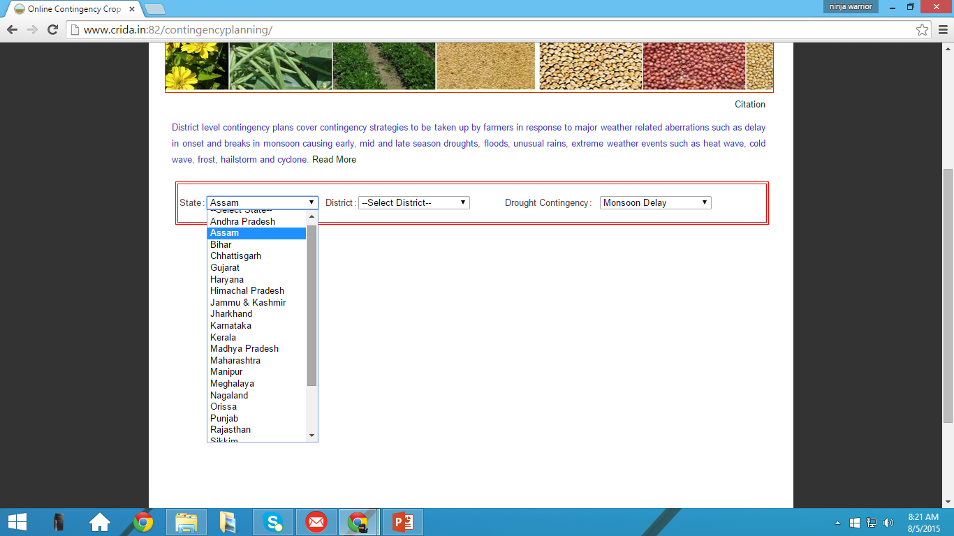

Slide 10
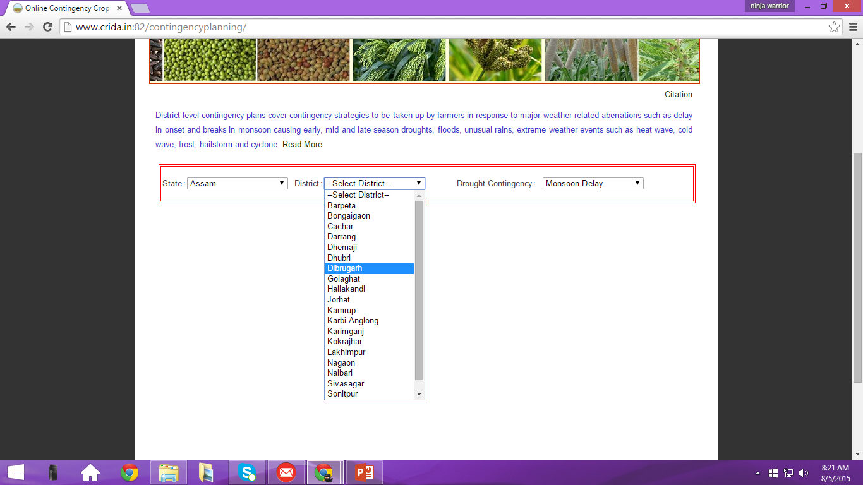

Slide 11
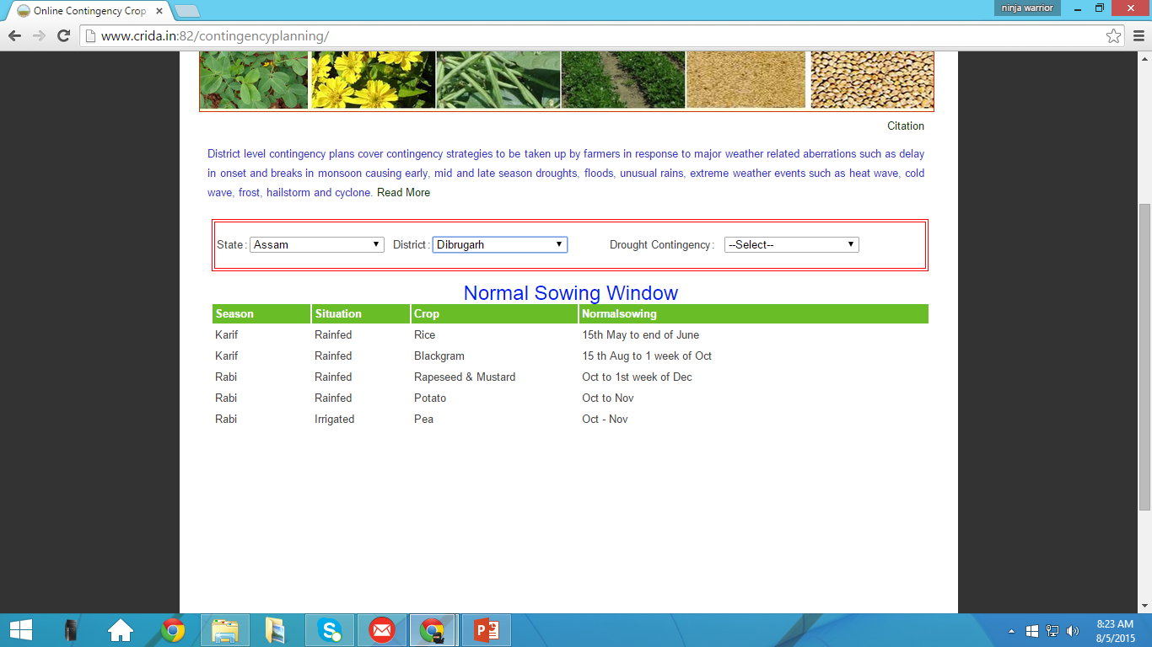

Slide 12
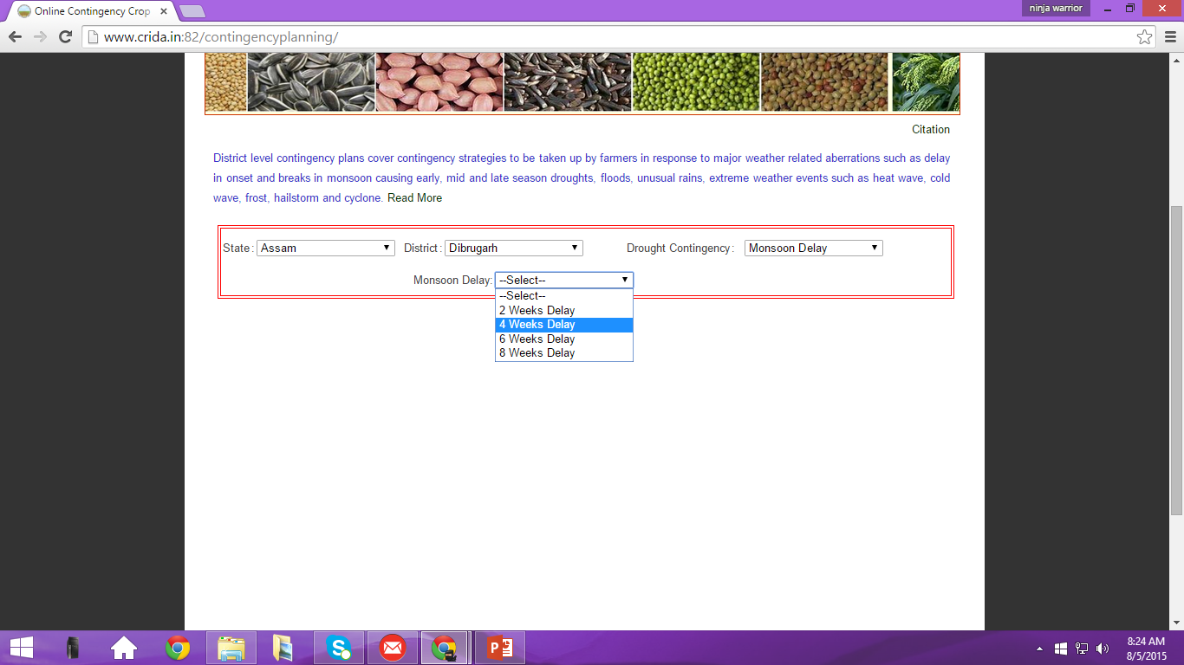

Slide 13
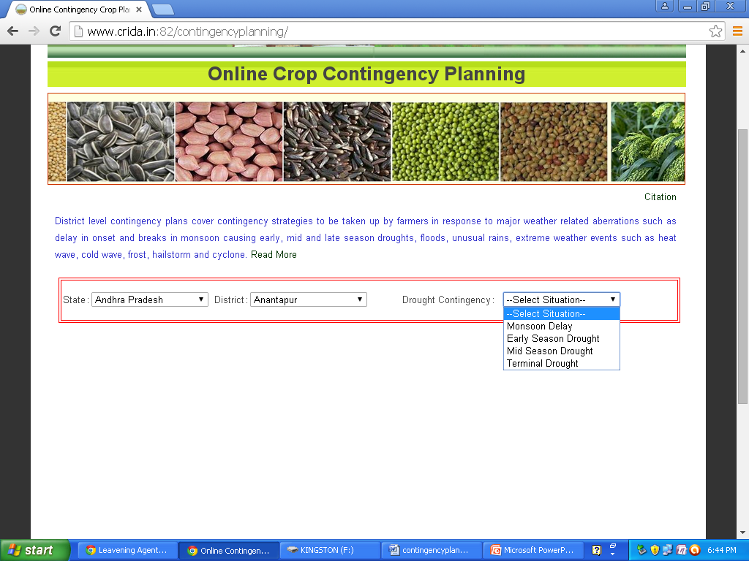

Slide 14
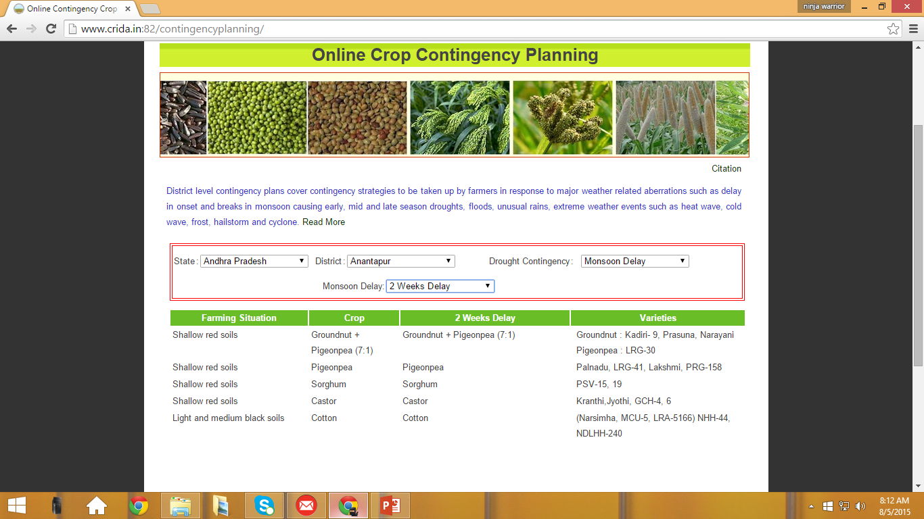

Slide 15
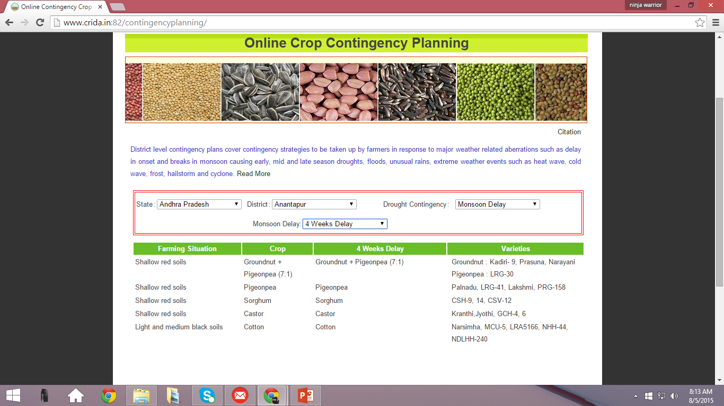

Slide 16
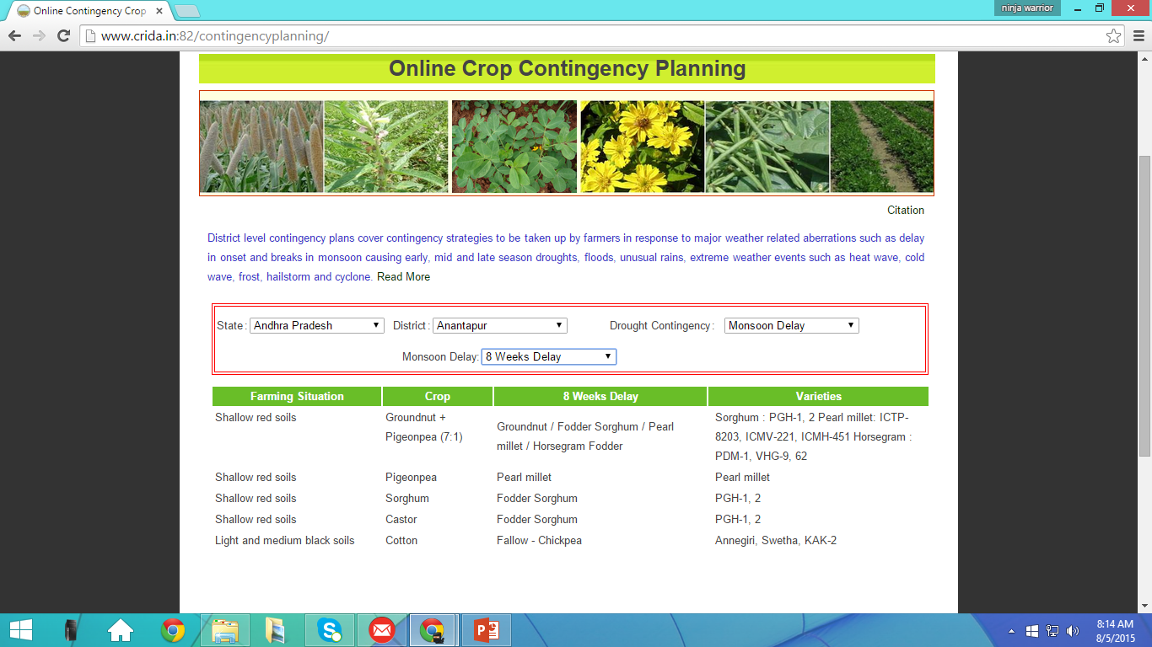

Slide 17
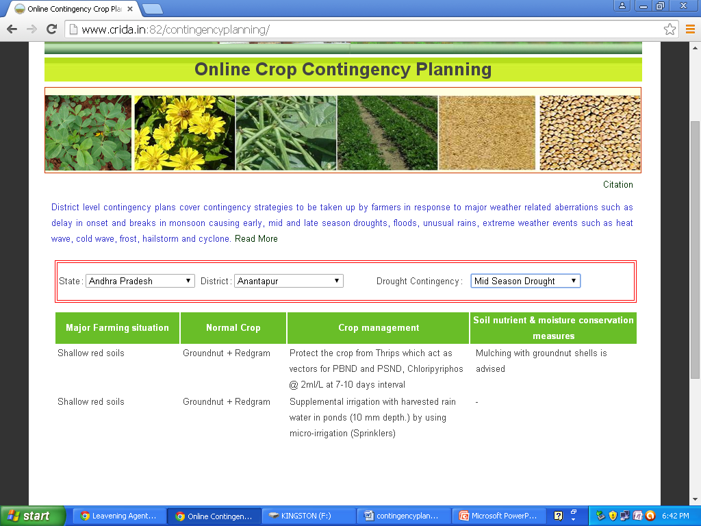

Slide 18
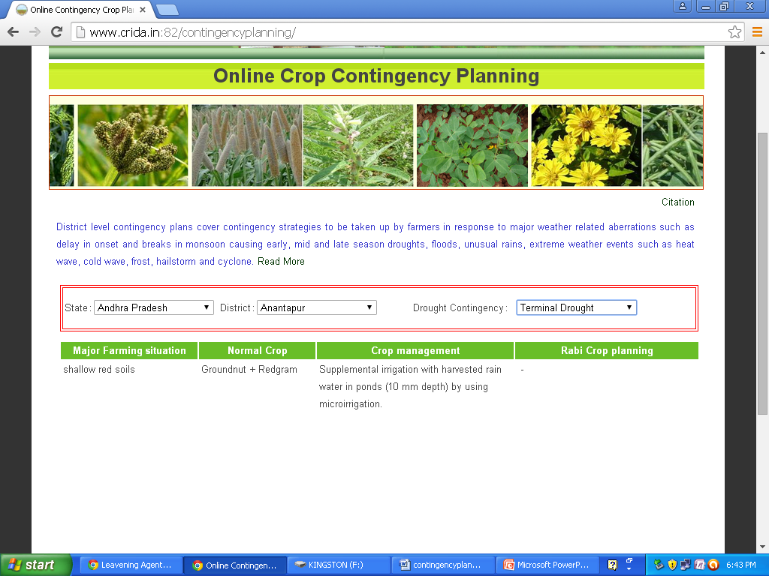

Slide 19
AICRP on Agro-Meteorology
Daily, weekly, monthly and annual data on the following 8 standard weather parameters from about 40 stations in India for variable time periods
Rainfall
Max temperature
Min temperature
RH (morning)
RH (Evening)
Wind speed
Sunshine hours
Evaporation

Slide 20
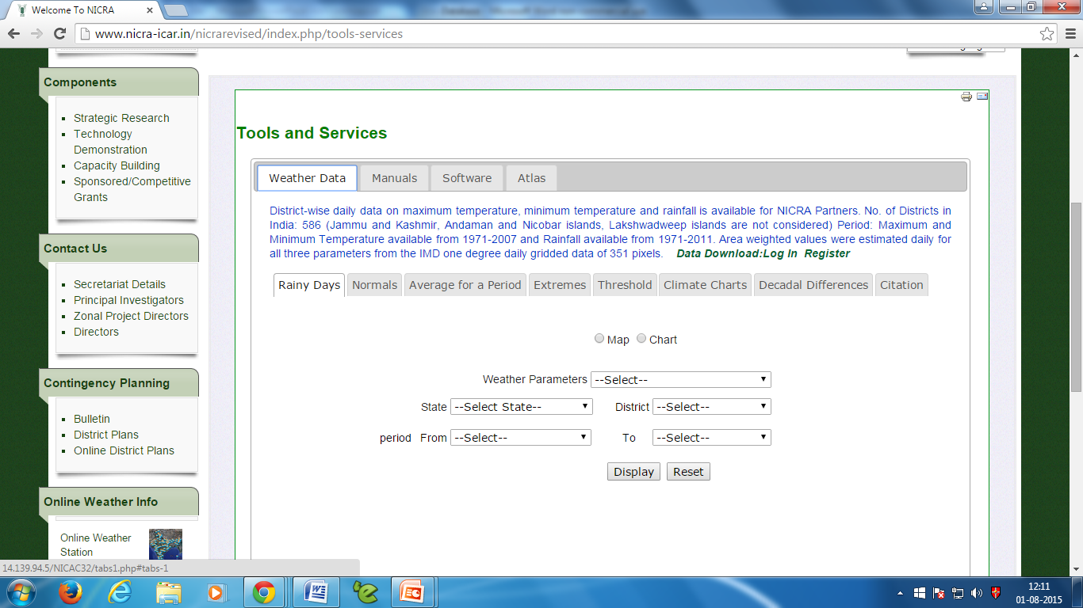

Slide 21
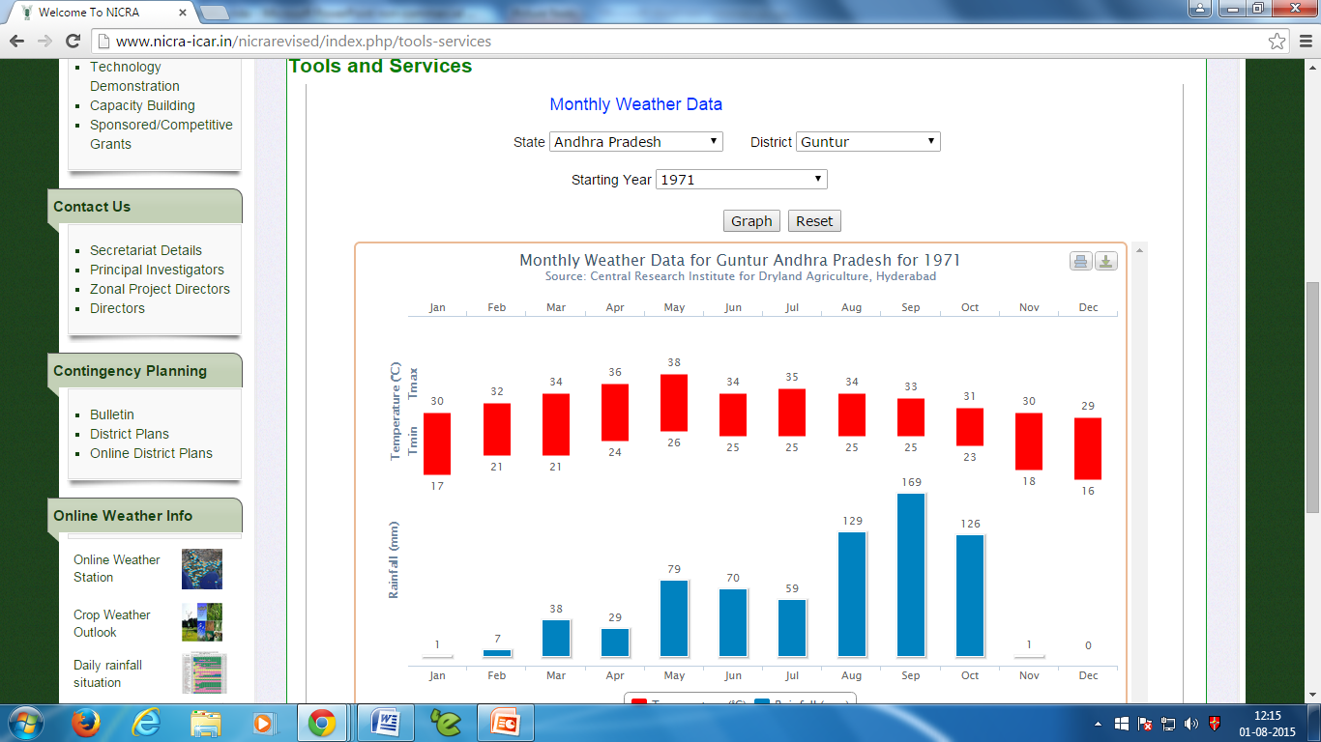

Slide 22
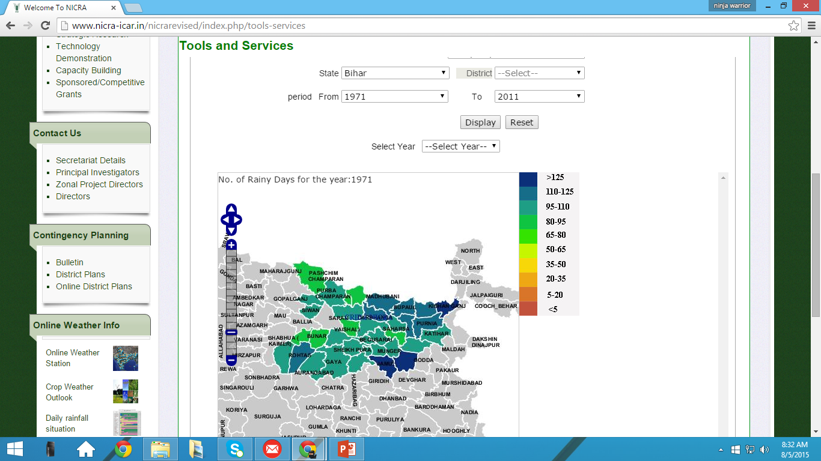
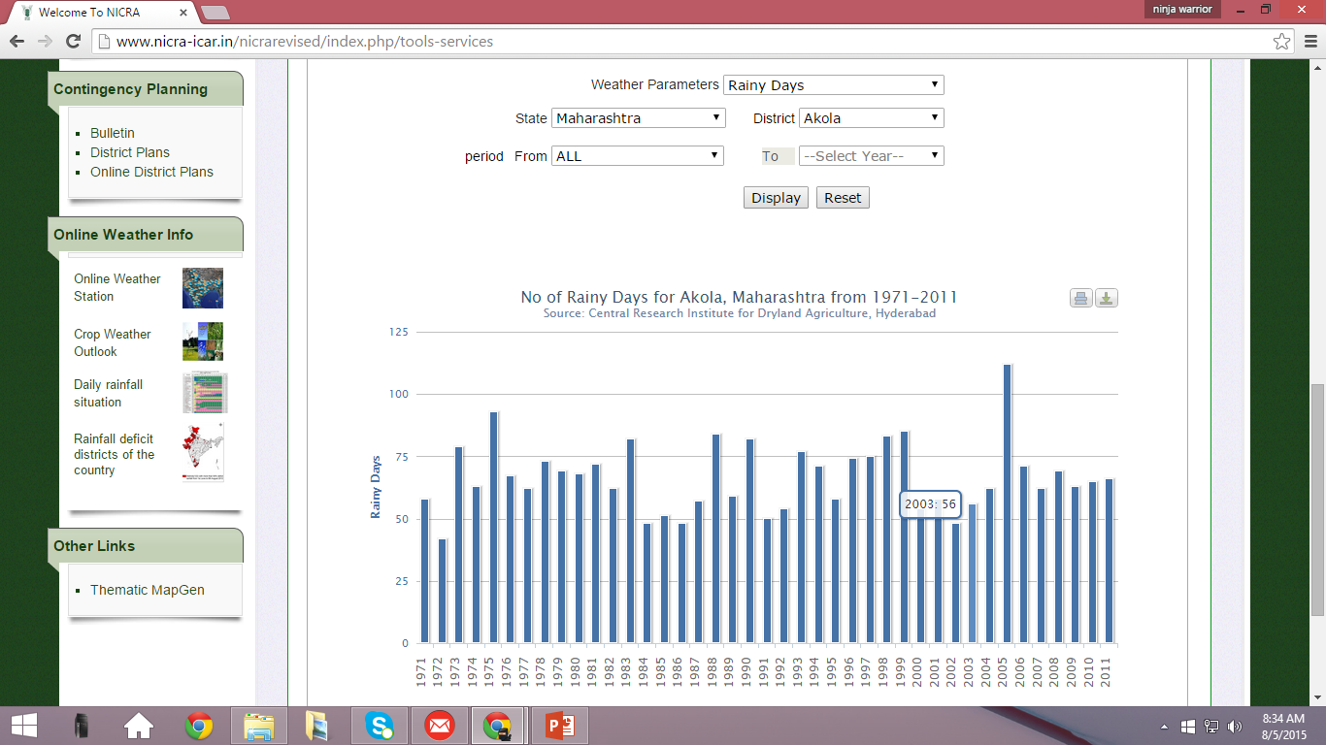

Slide 23
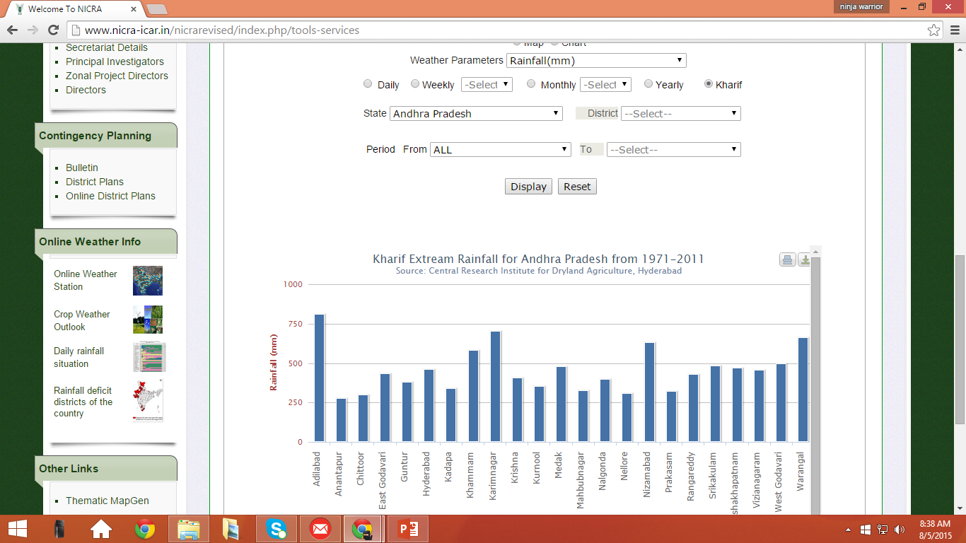

Slide 24
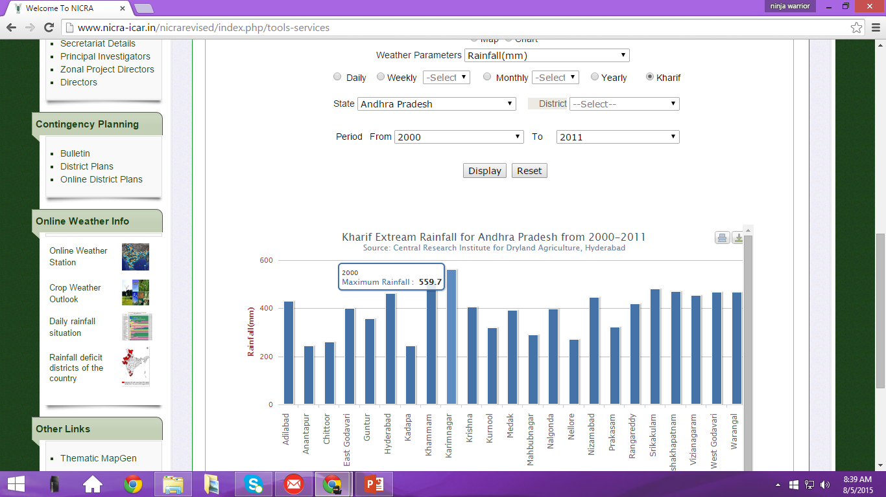

Slide 25
Thank You

